Slide 1
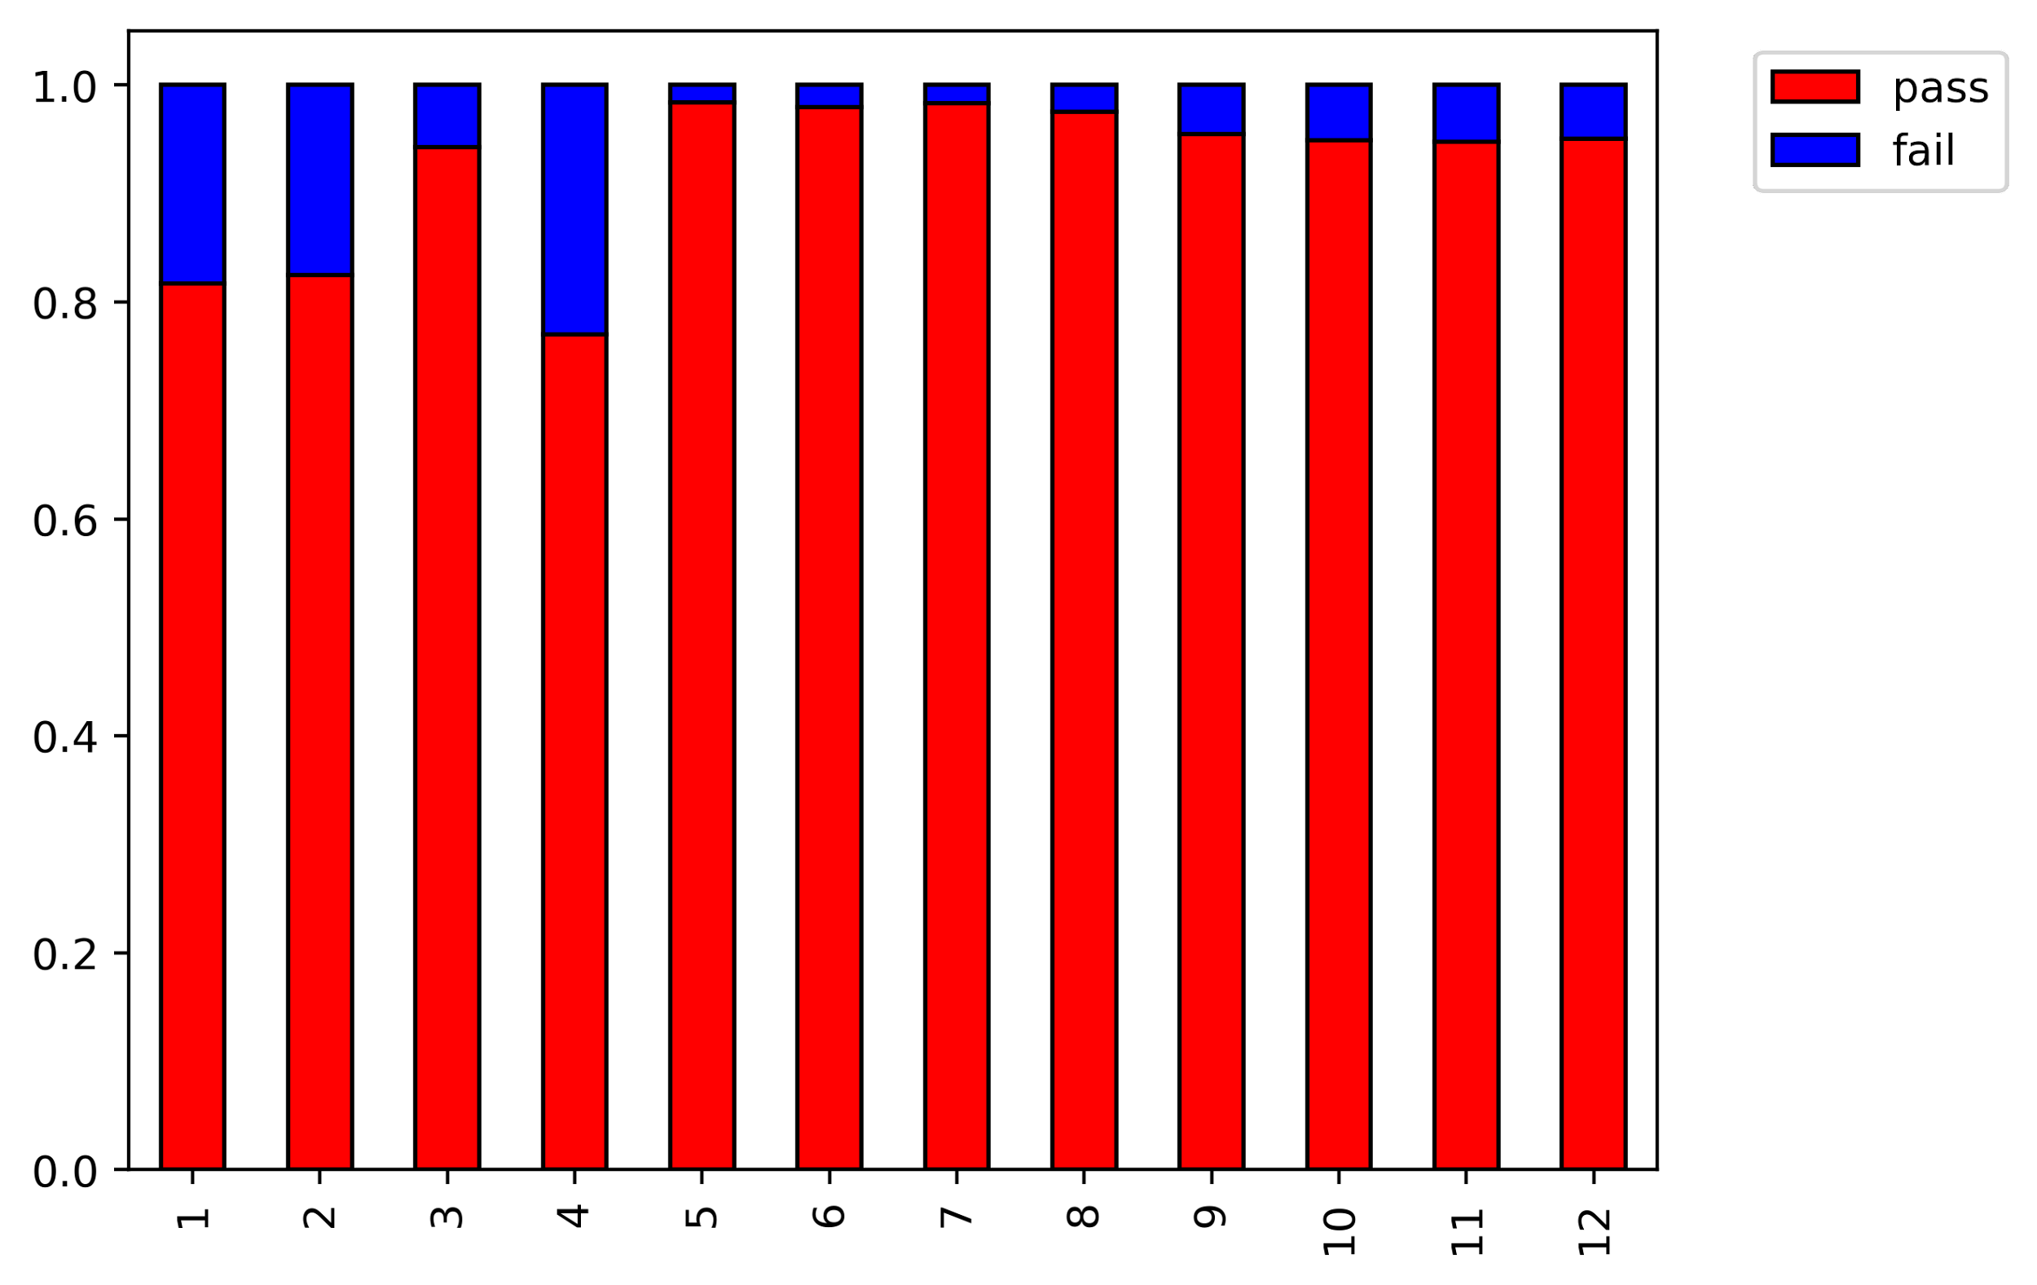
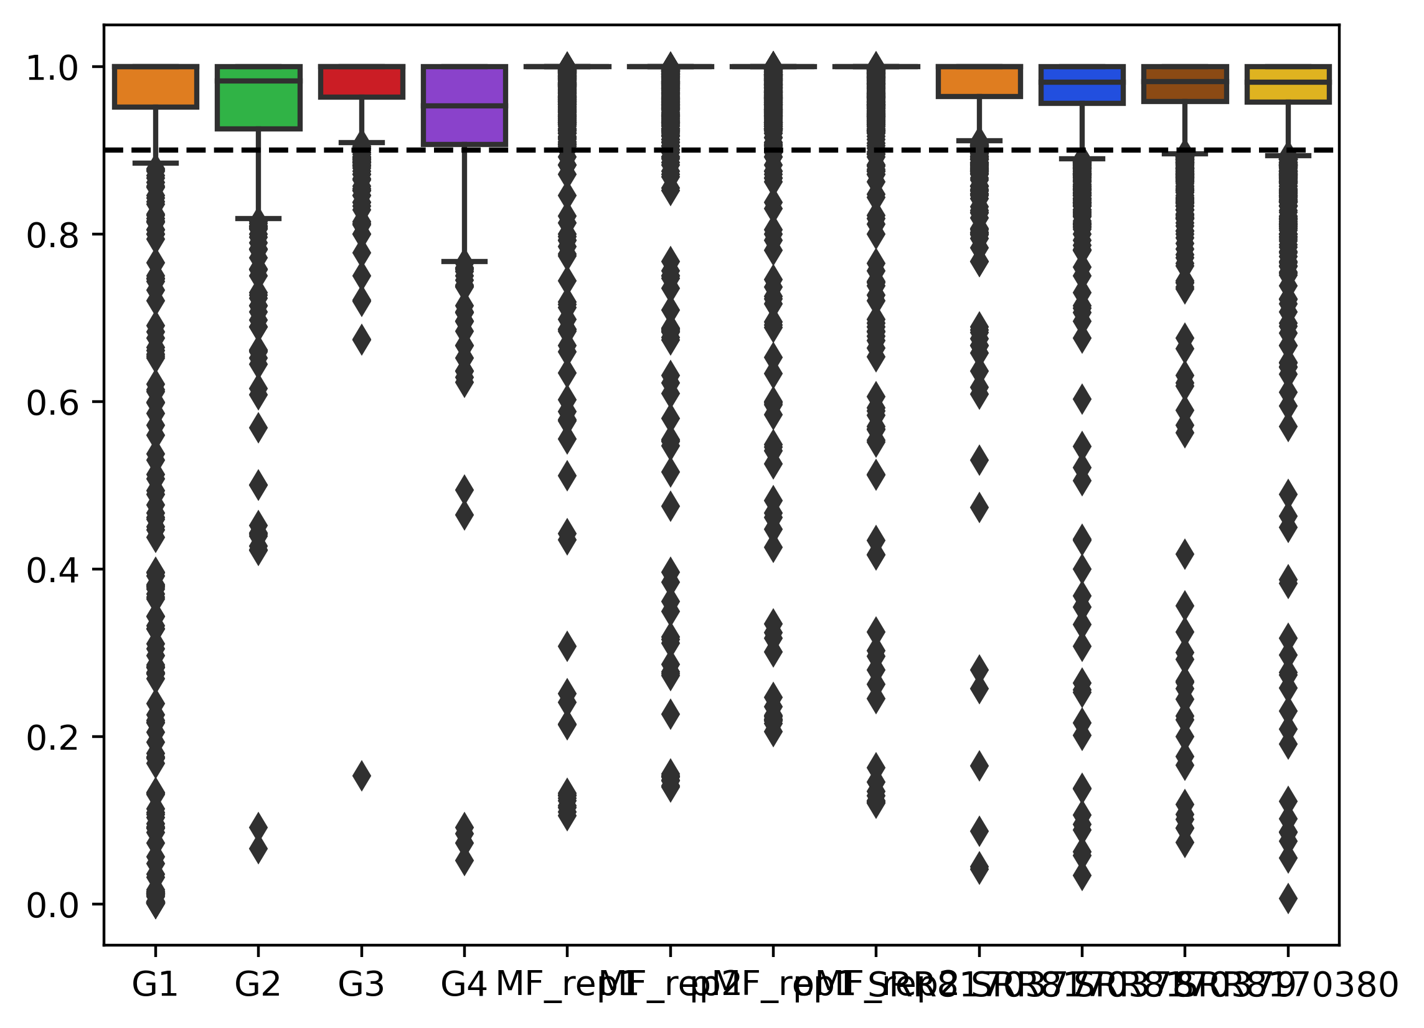
A
B
S/N ≥ 0.9
S/N < 0.9
Proportion
Signal / Noise
MT-B
MT-D
MT-B
MT-D
MT-A
MT-C
MT-A
MT-C
Huang rep 3
Huang rep 1
Polysome RNA rep 2
Polysome RNA rep 1
Huang rep 2
Total RNA rep 1
Huang rep 3
Total RNA rep 2
Huang rep 4
Huang rep 1
Polysome RNA rep 2
Polysome RNA rep 1
Huang rep 2
Total RNA rep 1
Total RNA rep 2
Huang rep 4
Notes:
(E) Percentage of sites above and below the signal/noise criteria (F) Distribution of signal/noise among all libraries. Dotted line represents the 0.9 cutoff.

